Slide 1
Research
Significance and Types of Research

Slide 2
Research in Technical Writing
Primary Research/Field Research
Secondary Research

Slide 3
Research in Technical Writing
Researched performed by you, generating information or data from a variety of sources that might include observations, tests of equipment, and laboratory experiments or field research.
Relying on already printed or published information taken from sources including books, periodicals, newspapers, encyclopedias, reports, proposals or other business documents. Secondary research requires citations

Slide 4
Field research
Preparing a survey or a questionnaire targeting a group of respondents
Conducting face‐to‐face interviews
Interviewing individuals through telephone calls and online surveys
Using social media, such as Twitter, Facebook, and LinkedIn, to collect information
Visiting job sites

Slide 5
Using Social Media for Research
Monitor customer comments
Monitor what people are saying about products/services (uberVu, Spiral16, SocialMention)
Access blog sites’ “most commented” sections
Pose research questions
Crowdsourcing (getting information from the general public
Collect, collate and analyze data synchronously from Facebook and Twitter by asking questions
Develop infographics
Infographics are tables and figures used for “data visualization” (Krum).
Use socials like delicious.com for findings statistics, data, visuals and more

Slide 6
Using Social Media for Research
Research the latest news
Use twitter hashtags to find trending news
Use hashtag “community driven…metadata” for more tailored results.
Quotes to support your ideas
Use http://search.twitter.com/, enter the hashtag #quotes or #quote, and type a keyword to find pertinent quotes (Gardner).
Access academic/research blogs
Academic research blogs related to science, archaeology and history.

Slide 7
Formal/Long Reports
Types and Steps to Writing a Long Report

Slide 8


Slide 9
What Are Formal Reports
A formal report is usually a factual and data-centered response to a research question.
Describes research methodology, presents results and discusses those results and makes recommendations.
General pattern for organization is tailored according to the specific reports

Slide 10
IMRaD report
Introduction
Methodology
Results
Graphics, graphs and tables
Discussion
Conclusions

Slide 11
Introduction
Introduction identifies the research question or hypothesis
Methodology explains the step-by-step how research was conducted
Results present facts, data and evidence collected while doing research
Graphics, graphs and tables illustrate the results of the research
Discussion of the results relating them to research question or hypothesis
Conclusion states the report’s main point and make recommendations

Slide 12
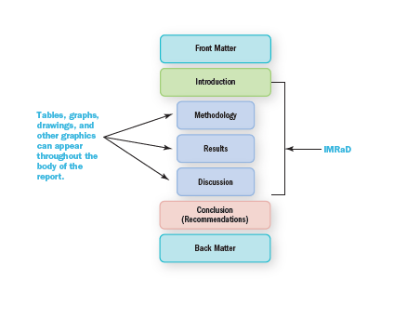

Slide 13
Goals of Long Formal Reports
To inform
Analyze a situation
Recommend action persuasively

Slide 14
Types of Long Reports
Information
Focus on the facts
Facts will help your readers understand the situation, the context, or the status of the topic
Analysis
Begin with factual information
Expand on the information by interpreting it and drawing conclusions
Recommendation
After information and analysis, recommend action as a follow-up
Allows you to tell the audience why purchase a product, use a service, choose a vendor, software package etc.

Slide 15
Recommendation Reports
Study a problem
Present possible solutions
Recommend actions to be taken

Slide 16
Feasibility Reports
A plan/product or course of action
Management unsure of decision
Report helps make a decision

Slide 17
Major Components of a Formal Report
Front matter, Text and Back matter

Slide 18
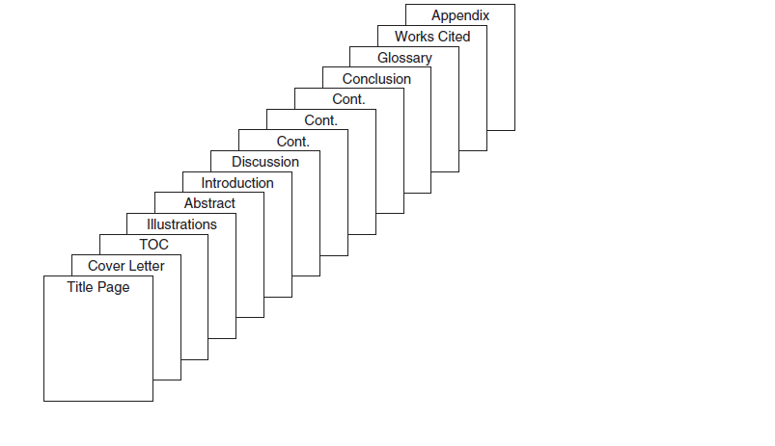

Slide 19
Major Components
Front matter
Text
Introduction
Back matter
Title Page
Cover Letter or Memo
Table of contents
List of illustrations
Abstract or Executive Summary
Including Purpose
Issues
Background
Problems
Discussions
Conclusion/Recommendation
Glossary
Works cited or references page
Optional Appendix

Slide 20
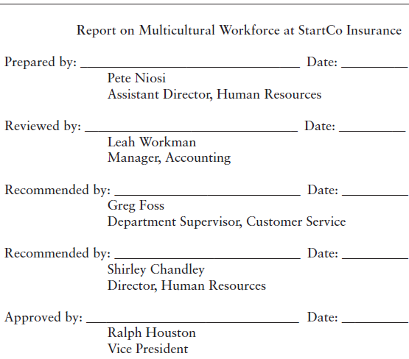
Title Page
Title of the long report
Name of the company and writer(s) submitting the report
Date on which the report was completed

Slide 21
Cover Letter or Memo
Why you are writing
What you are writing about (subject)
What is exactly of importance within this report
What you plan to do next as a follow-up
When the action should occur
Why the date is important

Slide 22
Table of Contents
Table of contents are read by many different readers, each of whom will have a special area of interest.
Your responsibility to help readers find the sections of the report that interest them.
The table of contents should be a complete and accurate listing of main and minor topics covered in the report.

Slide 23
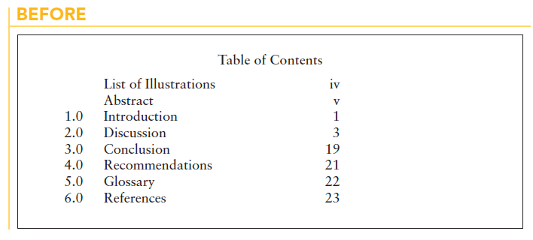

Slide 24
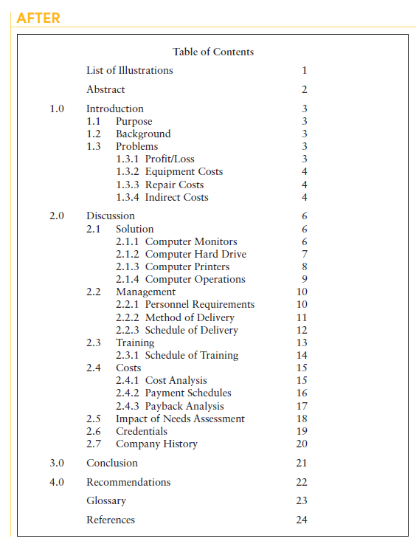

Slide 25
List of illustrations
If several tables of figures, provide a list of illustrations
It must be clear and informative
Make sure its well developed

Slide 26
Steps to Write a Formal Report
Plan, Organise, Draft and Style/Design a Long Report

Slide 27
Step 1: Make a Plan and Do Research
Planning
Who might read this report
Why was this report requested?
What kind of information or content do readers need?
Where will this report be read?
When will this report be read?
How will this report be used?
Subject
What exactly will the report cover?
What kind of information and facts do readers need to know to make a decision?
Purpose
What should the report accomplish?
What do the readers expect it to accomplish?
What is its main goal or objective?

Slide 28
Purpose: Language considerations
Purpose should be a one-line statement
“The purpose of my report is to….”
Use an action verb to express what report will do

Slide 29
